Slide 1
Effects of Noise on Energy (as a function of random parameter values)
Meeting with Professor Schnetzer
October 28, 2020

Slide 2
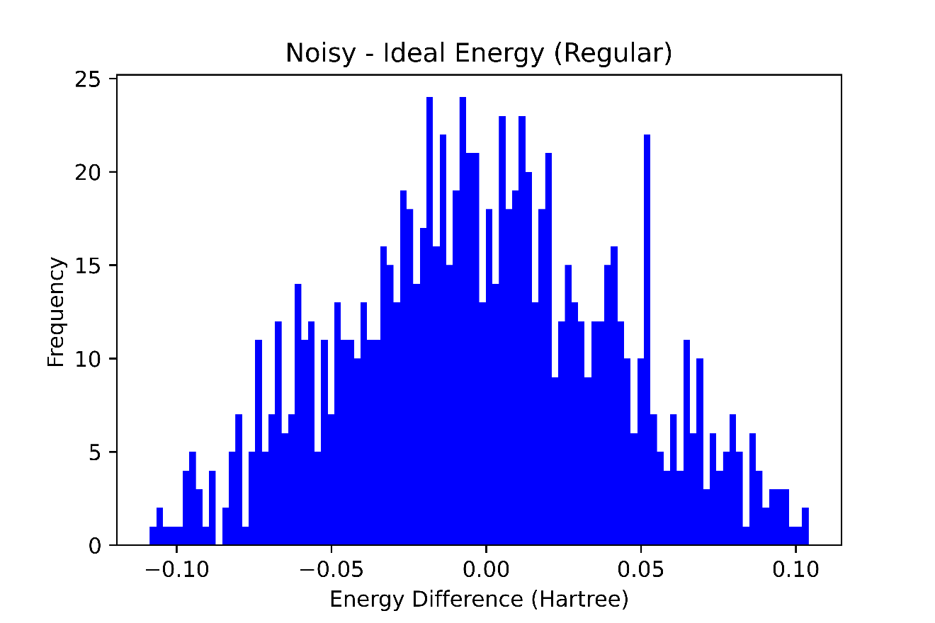
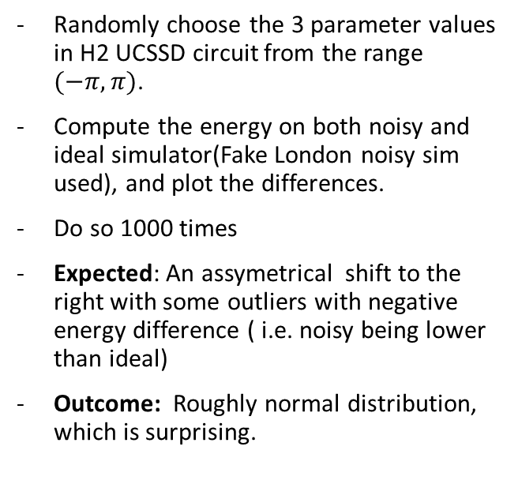
Experiment
Randomly choose the 3 parameter values in H2 UCSSD circuit from the range $(−π, π)$.
Compute the energy on both noisy and ideal simulator(Fake London noisy sim used), and plot the differences.
Do so 1000 times
Expected: An assymetrical shift to the right with some outliers with negative energy difference ( i.e. noisy being lower than ideal)
Outcome: Roughly normal distribution, which is surprising.

Slide 3
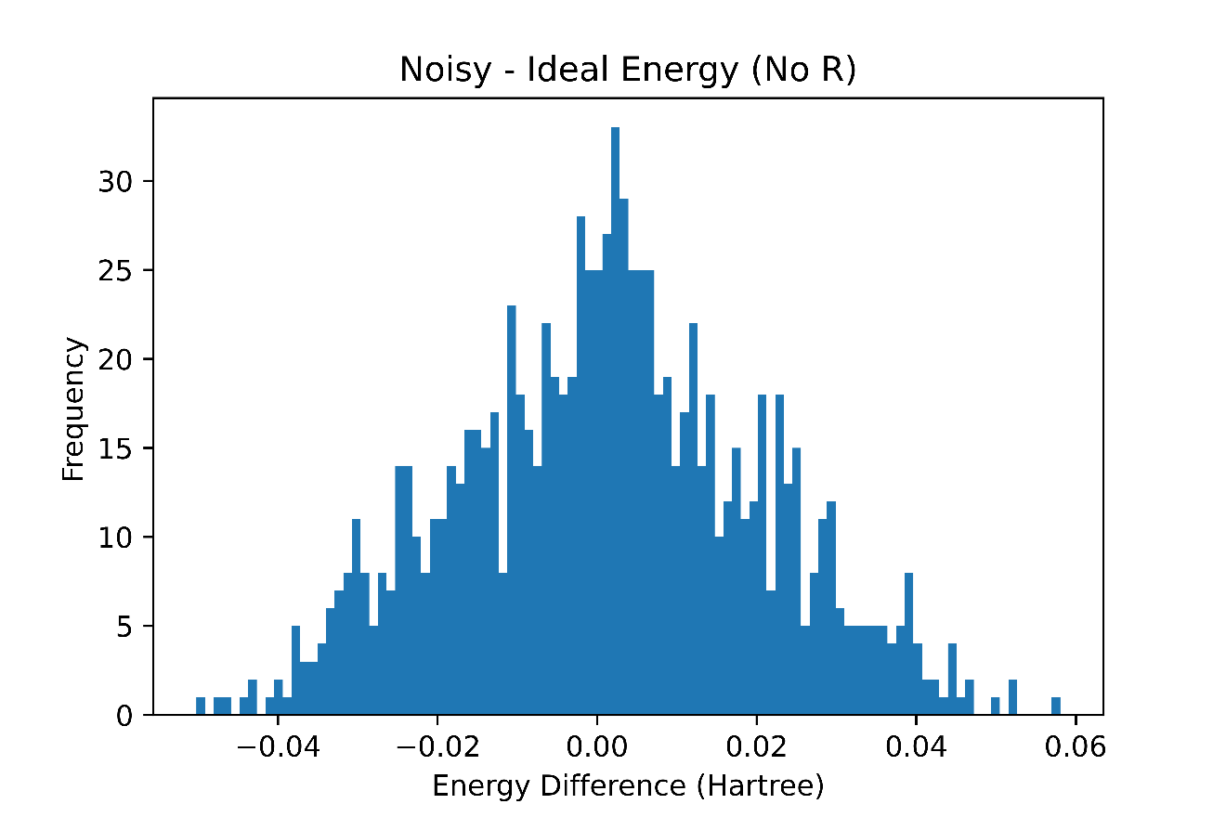
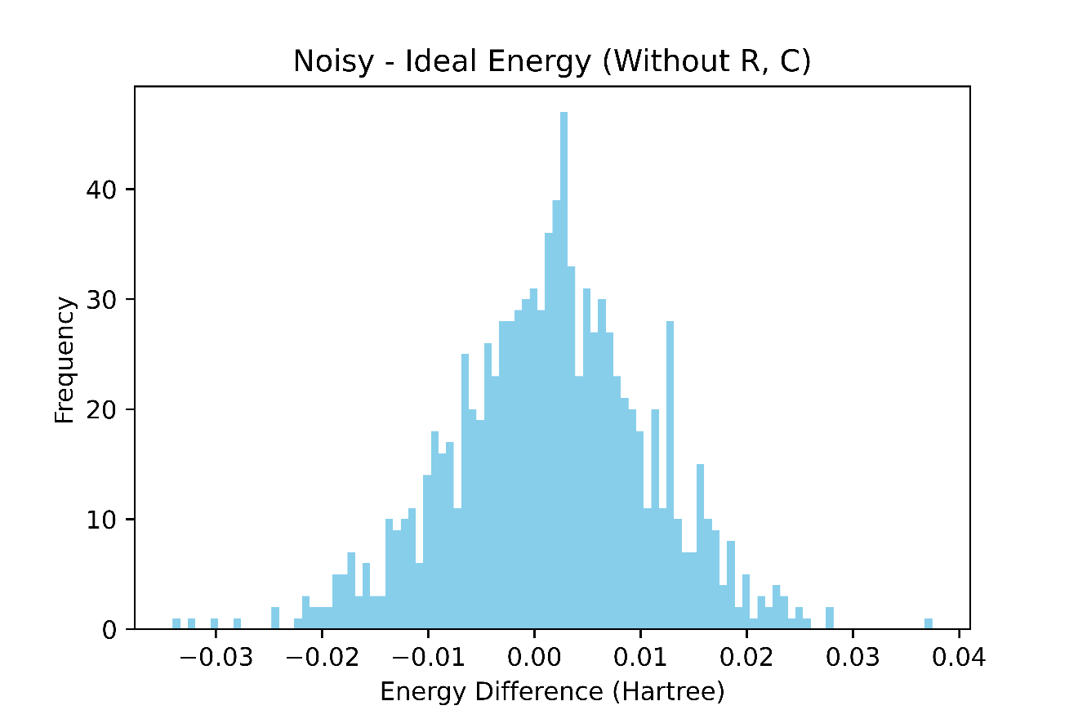
Isolating individual error types
(R) refers to readout errors and (C) refers to coherent errors
There seems to be huge change in spread when we remove readout errors – approx. reduction by a factor of 3
In the bottom plot, we expect incoherent errors to have some asymmetrical effect but that is not shown by the plot

Slide 4
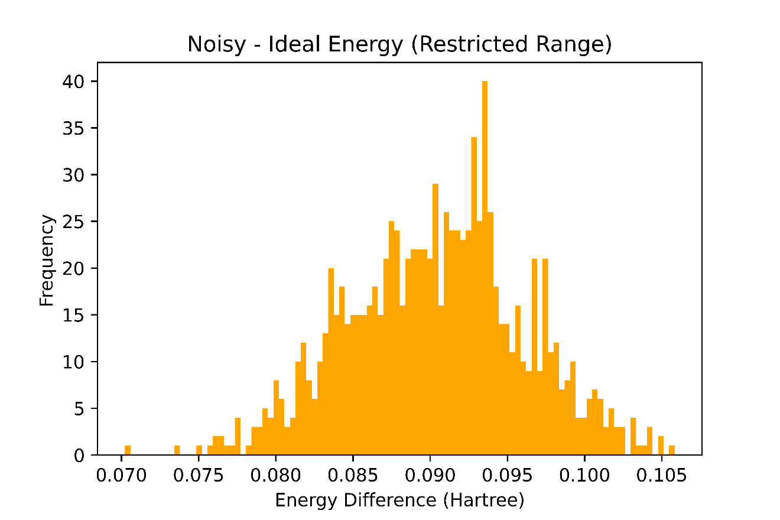
Restricting the Range of parameters about optimized parameters
Obtaining the parameters after VQE finished optimizing (H2 at 0.74 ang sep.) on FakeLondon noisy simulator, we get
[ 0.00172129 -0.00182397 -0.11217598]
So the range for the 3 parameters was restricted to :
[0.0015 +/- 0.0005, -0.0015+/- 0.0005, 0.15+/- 0.05 ] Then sampling parameters from this range, we get the following plot.
Expected: From slide 2, we would expect the same normal distribution centered at 0
Reality: A significant asymmetrical shift to the right.

